Slide 1
StackGAN: Text to Photo-realistic Image Synthesis
with Stacked Generative Adversarial Networks
JONGWOOK-SI
Kumoh National Institute of Technology, Korea
Dept. Of Computer Engineering

Slide 2
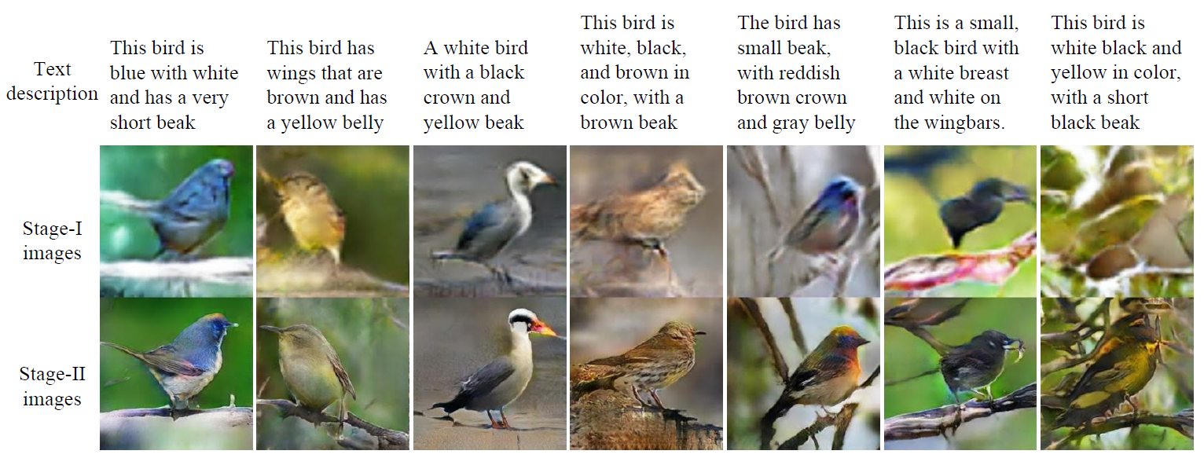
StackGAN
Introduction

Slide 3
StackGAN
2 - Stage Network
Stage-I GAN 1) Sketch the shape and color of the object according to the text description 2) Plot background layout on random noise vectors 3) Create low-resolution images (64x64) Stage-II GAN 1) Re-read the results and text descriptions of Stage-I
2) Create a high-resolution image (256x256)

Slide 4
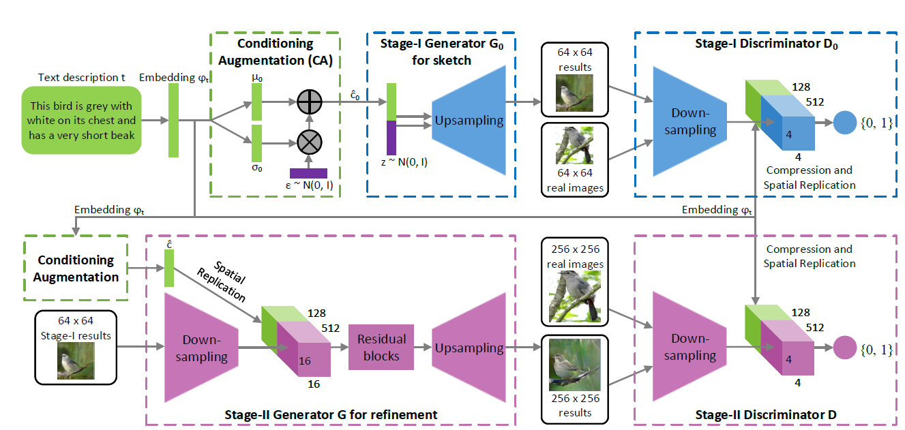
StackGAN
Network

Slide 5
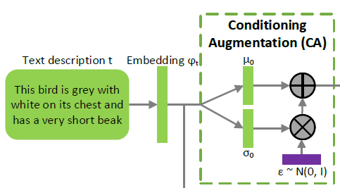
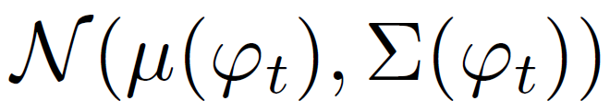
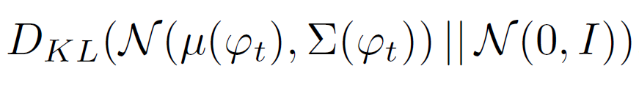
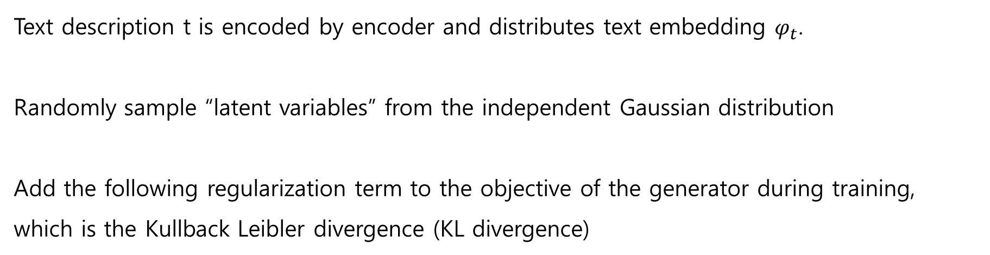
StackGAN
Conditioning Augmentation
Text description t is encoded by encoder and distributes text embedding $φ_{t}$.
Randomly sample “latent variables” from the independent Gaussian distribution
Add the following regularization term to the objective of the generator during training, which is the Kullback Leibler divergence (KL divergence)

Slide 6
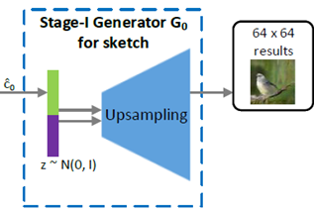
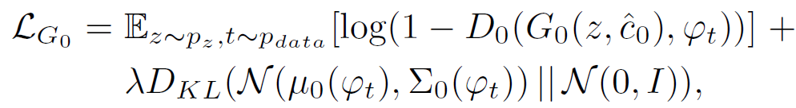
StackGAN
Stage-I GAN - Generator
C – vector representing input sentence
Z – noise sampled from a unit gaussian distribution
Lamda is a regularization parameter that balances the two terms in Eq.

Slide 7
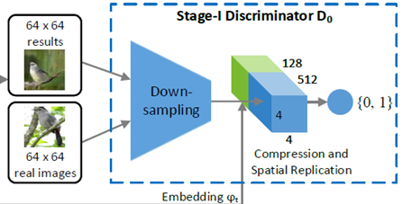
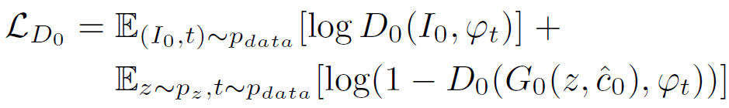
StackGAN
Stage-I GAN - Discriminator
Images
64x64x3 -> 4x4x512
Text
Fully-connected layer: 128
Spatially replicate to 4x4x128
Depth Concatenate
Total of 4x4x640

Slide 8
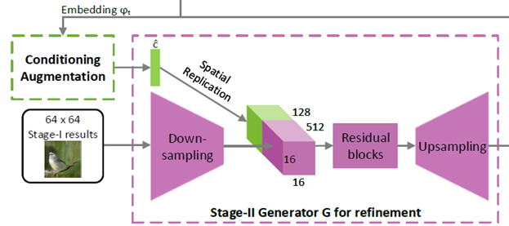
StackGAN
Stage-II GAN - Generator
1) Stage-II GAN is built upon Stage-I GAN results to generate high-resolution images
2) Stage-II GAN learns to capture useful information in the text embedding that is omitted
by Stage-I GAN.

Slide 9
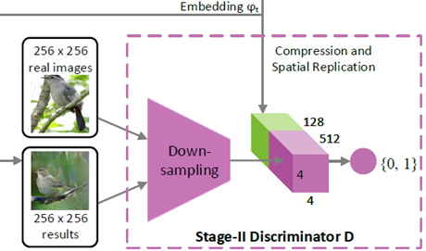
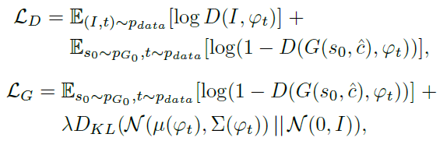
StackGAN
Stage-II GAN - Discriminator
Down-sampling : Same as Stage-I, but more layers (Image Size)

Slide 10
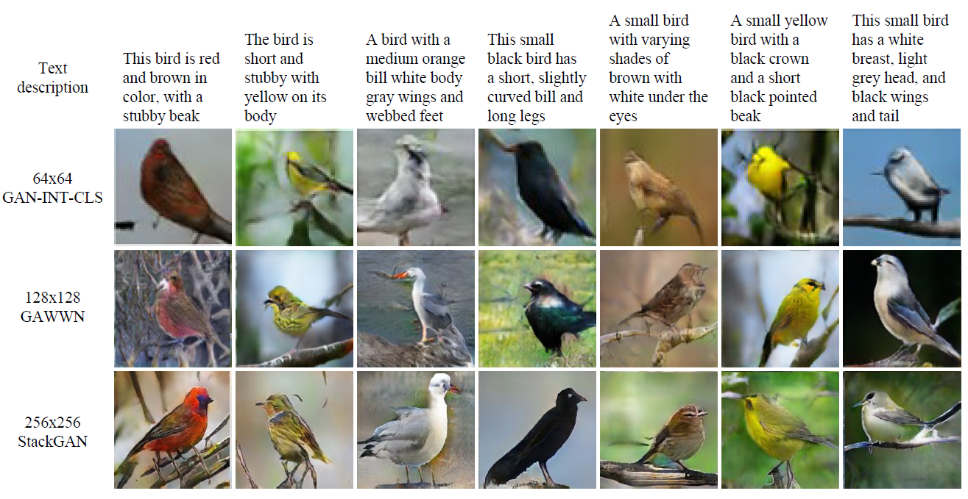
StackGAN
Quantitative and qualitative results

Slide 11
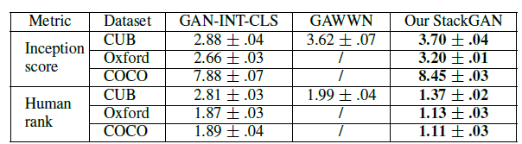
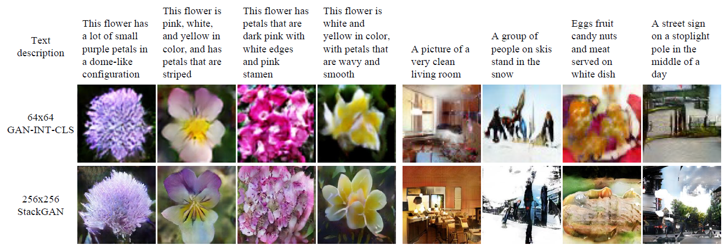
StackGAN
Quantitative and qualitative results

Slide 12
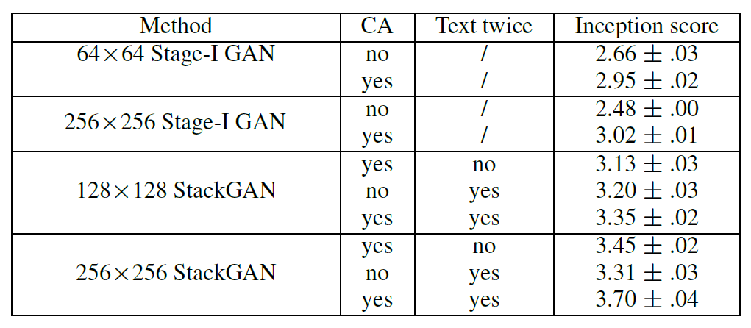
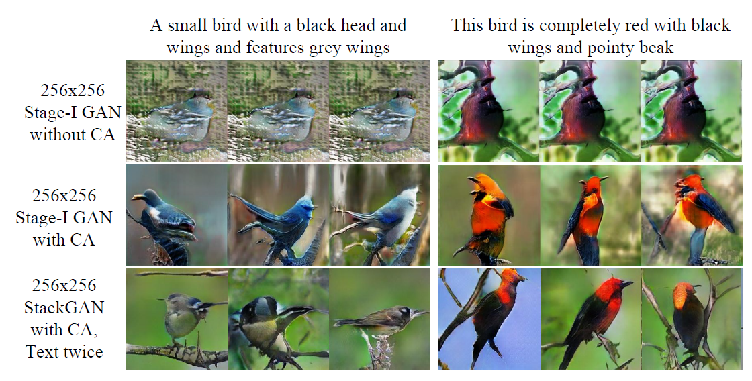
StackGAN
Analysis (CA)

Slide 13
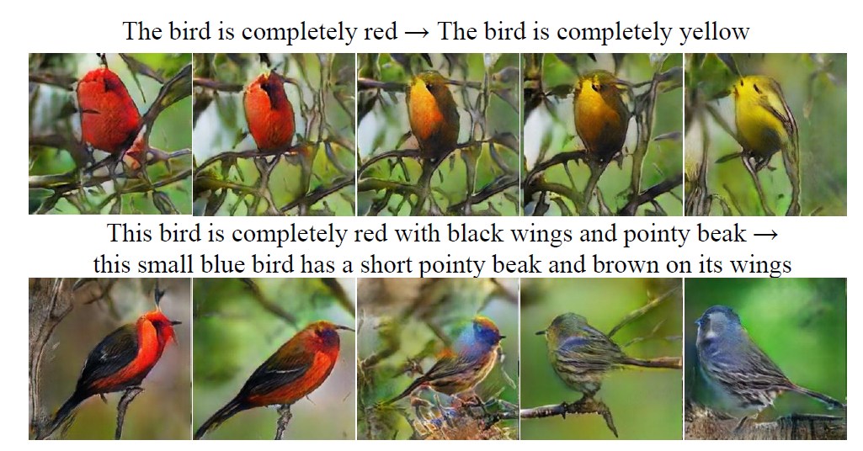
StackGAN
Analysis (Text Embedding)

Slide 14
Photo-Realistic Single Image Super-Resolution Using a Generative Adversarial Network
JONGWOOK-SI
Kumoh National Institute of Technology, Korea
Dept. Of Computer Engineering

Slide 15
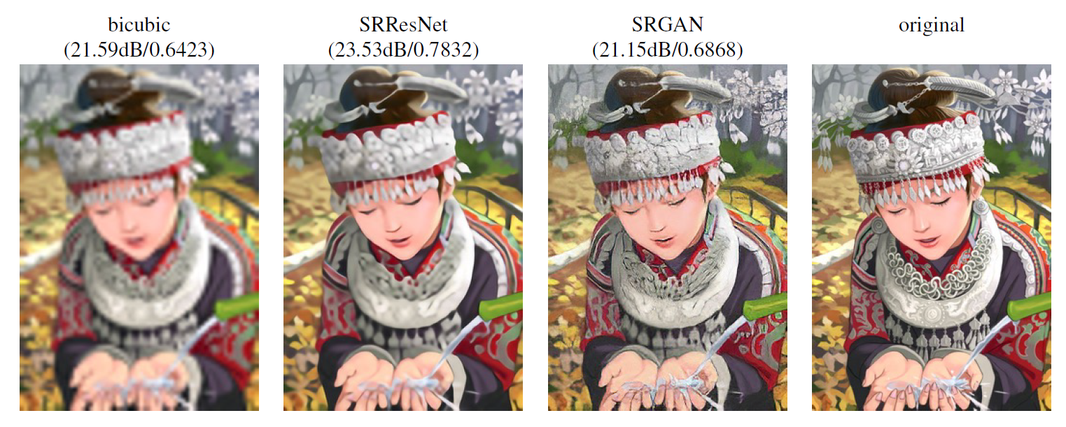
SRGAN
Image Resolution
Realistic

Slide 16
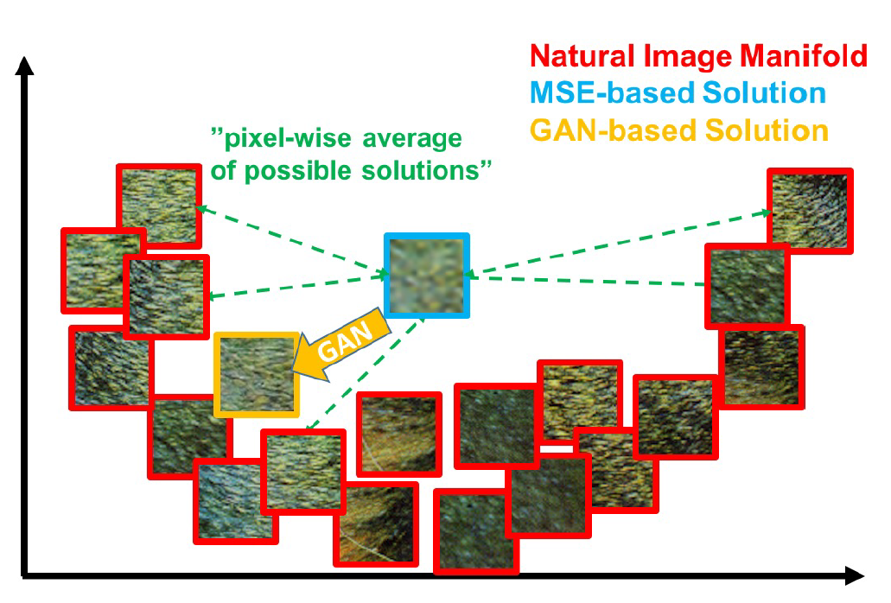
SRGAN
MSE
Minimizing MSE encourages finding pixel-wise averages of plausible solutions which are typically overly-smooth and thus have poor perceptual quality

Slide 17
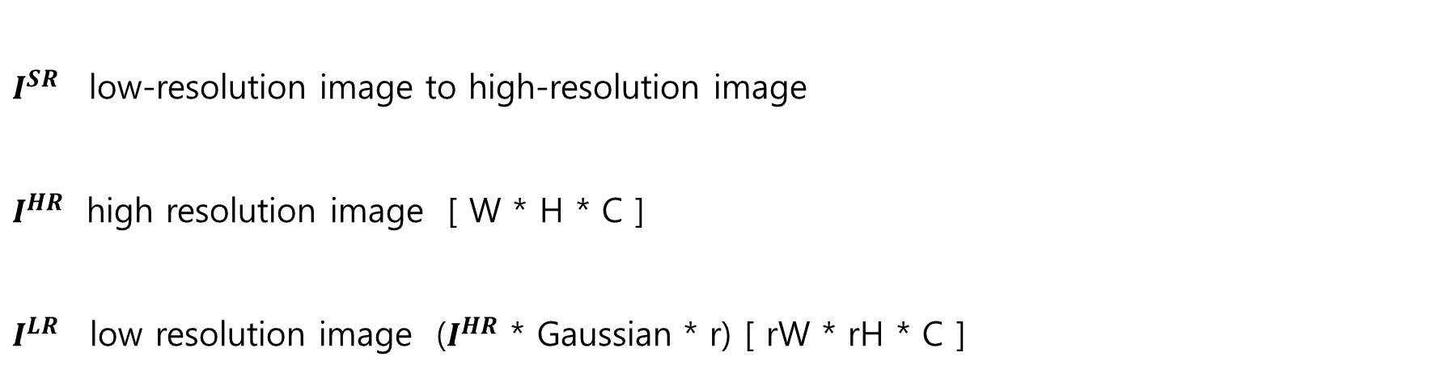
SRGAN
Training
$I^{SR}$low-resolution image to high-resolution image
$I^{HR}$ high resolution image [ W * H * C ]
$I^{LR}$ low resolution image ($I^{HR}$ * Gaussian * r) [ rW * rH * C ]

Slide 18
SRGAN
DownSampling Algorithm
- Reduction Image Size
OutImage[newi][newj] = (InputImg[i][j] + InputImg[i+1][j] +
InputImg [i][j+1] + InputImg[i+1][j+1]) / r

Slide 19
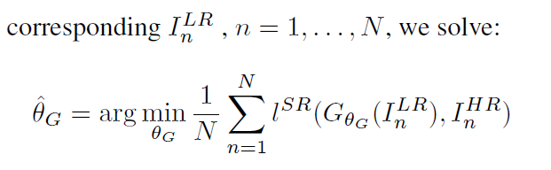
SRGAN
Training

Slide 20
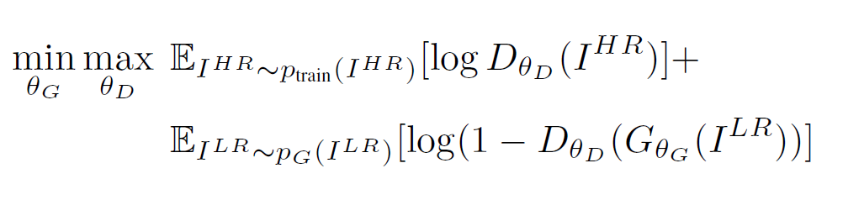
SRGAN
Training

Slide 21
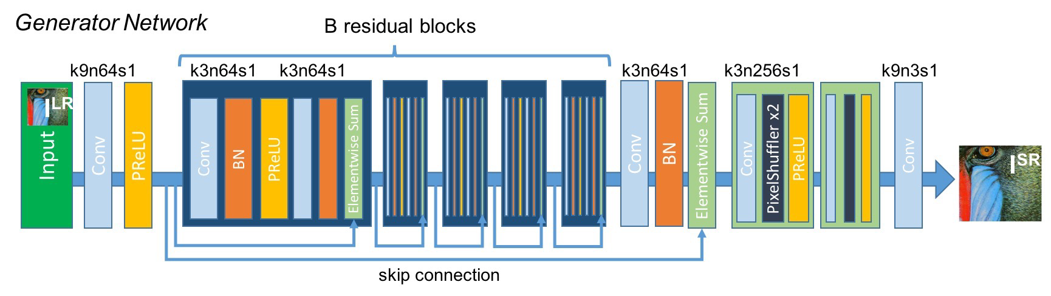
SRGAN
Generator Network

Slide 22
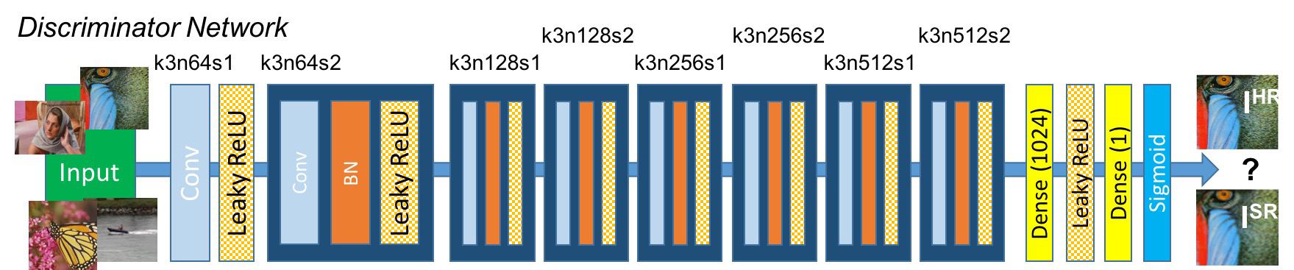
SRGAN
Discriminator Network

Slide 23
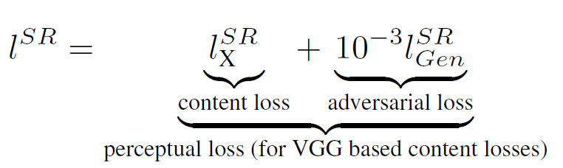
SRGAN
Perceptual loss function

Slide 24
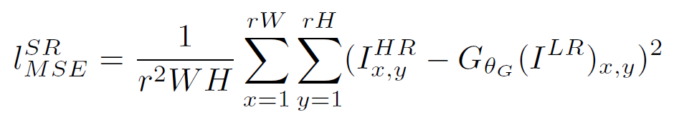
SRGAN
Content loss (MSE)

Slide 25
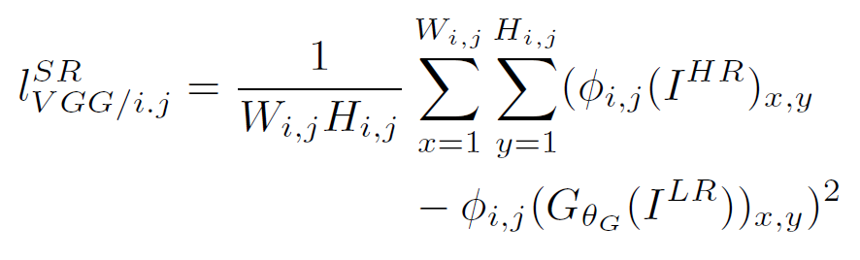
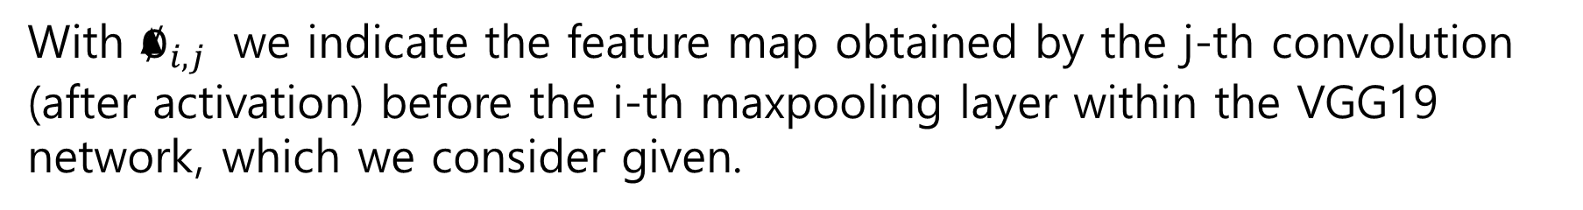
SRGAN
Content loss (VGG loss)
With $∅_{i,j}$ we indicate the feature map obtained by the j-th convolution (after activation) before the i-th maxpooling layer within the VGG19 network, which we consider given.

Slide 26
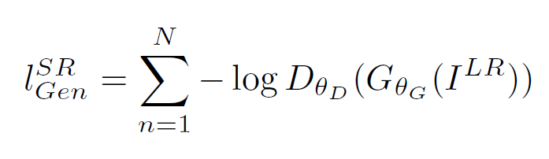
SRGAN
Adversarial loss

Slide 27
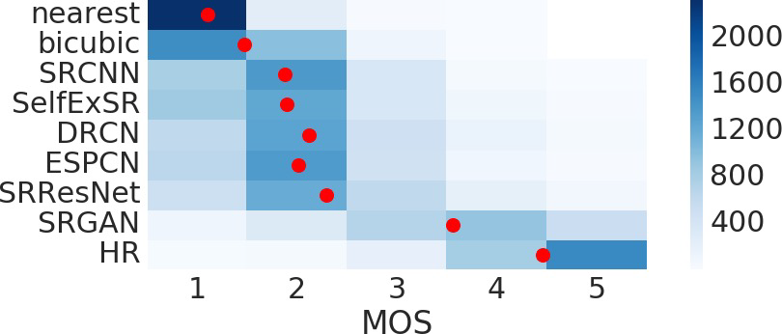
SRGAN
MOS
Asking 26 raters to assign an integral score from 1 (bad quality) to 5 (excellent quality) to the super-resolved images.

Slide 28
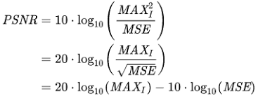
SRGAN
PSNR
- The ratio of noise to the maximum signal a signal can have. - Used to evaluate picture loss information in loss compression

Slide 29
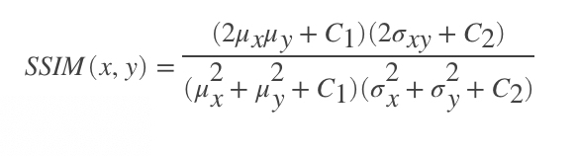
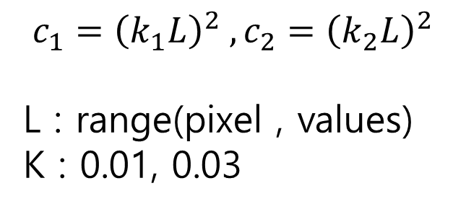
SRGAN
SSIM
$$c_{1}={\left(k_{1}L\right)}^{2} , c_{2}={\left(k_{2}L\right)}^{2}$$
L : range(pixel , values)
K : 0.01, 0.03
A method of measuring similarity of the original image against distortion

Slide 30
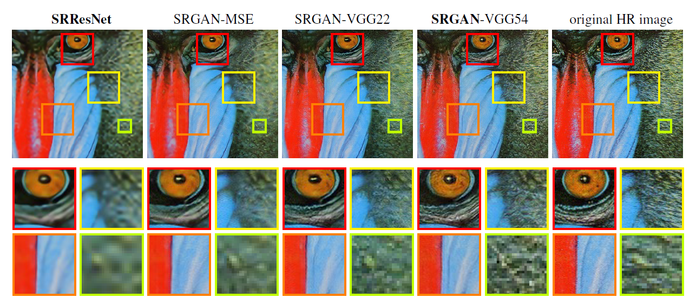
SRGAN

Slide 31
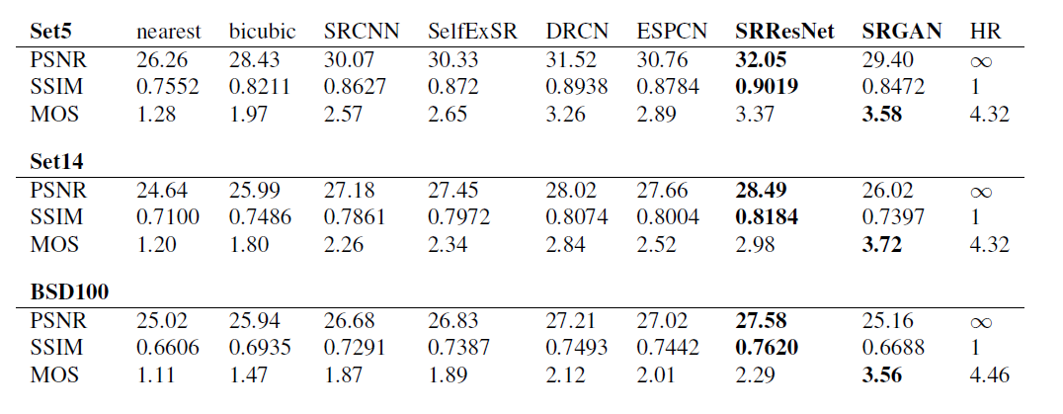
SRGAN

Slide 32
Analysis of Golf Swing Track
Using Correlation Matrix
JONGWOOK-SI
Kumoh National Institute of Technology, Korea
Dept. Of Computer Engineering

Slide 33
Analysis
시작
계열 1과 나머지와의 비교 -> 당연히 X,Y 모두 양의 선형관계

Slide 34
Analysis
계열 1과의 비교 | X’s r | Y’s r | score
계열 1 | 1.000000 | 1.000000 | 1.000000
계열 2 | 0.998918 | 0.982240 | 0.990579
계열 3 | 0.993204 | 0.953768 | 0.973486
계열 4 | 0.988803 | 0.914630 | 0.951717
궤적이 크게 다른 경우임에도 불구하고 굉장히 높은 score가 도출

Slide 35
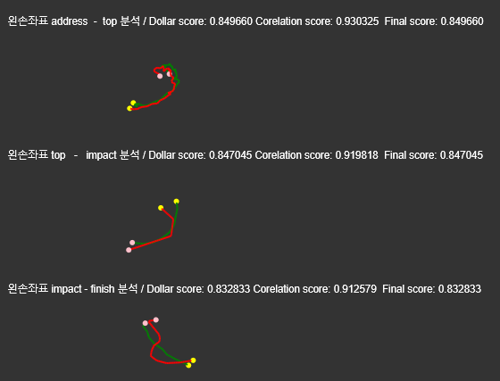
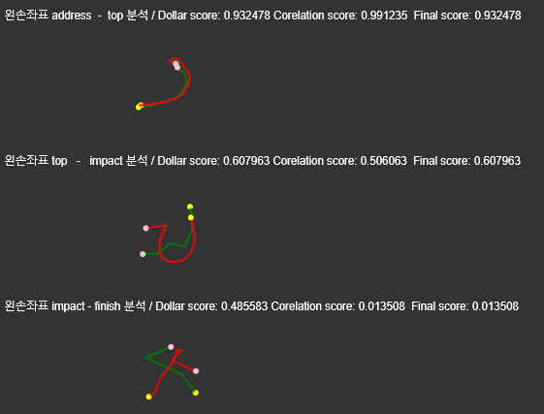
Analysis
둘다 양의 선형관계인 경우만 기존의 방법으로 score 도출

Slide 36
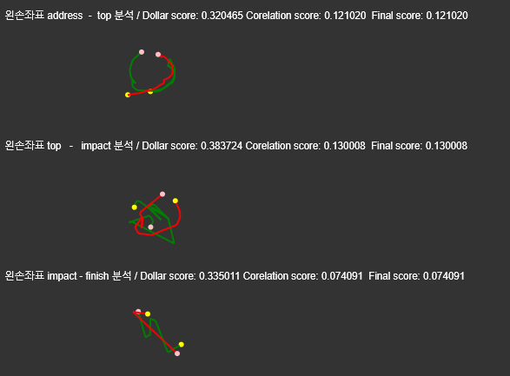
Analysis

Slide 37
Creating Image of Portrait Style
in Joseon Dynasty Period Using CycleGAN
JONGWOOK-SI
Kumoh National Institute of Technology, Korea
Dept. Of Computer Engineering

Slide 38
Idea Introduction
DataSet
 | A | B | SUM
Train | 326 | 312 | 638
Test | 44 | 49 | 91
Ratio | 88.11% | 82.46% | 85.74%
 | A | B | SUM
Train | 1103 | 1058 | 2261
Test | 210 | 156 | 366
Ratio | 84.01% | 87.15% | 86.08%

Slide 39
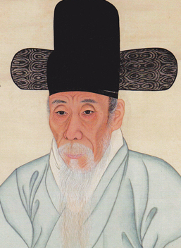
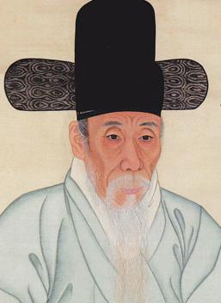
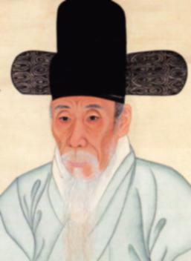
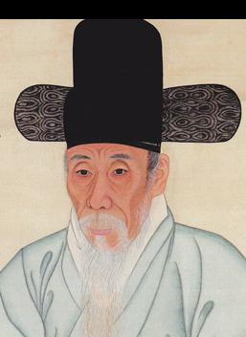
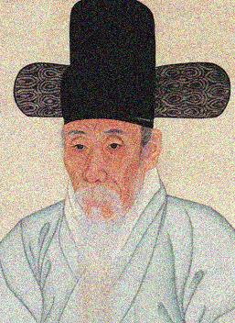
Idea Introduction
Data Augmentation
LR conversion Blur Translation noise

Slide 40
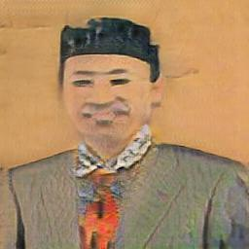
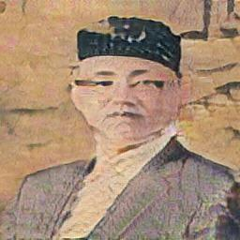
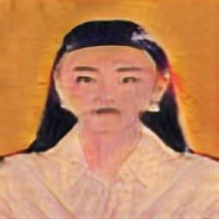
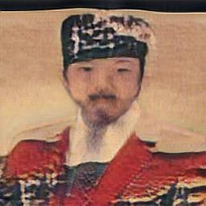
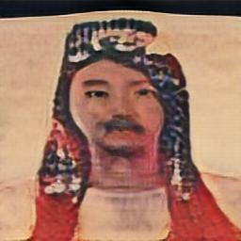


Result
(60 / 200 epoch)
30% …

Slide 41








Result
(60 / 200 epoch)
Where is eyes?

Slide 42



Result
Problems

Slide 43

Result
Solution

Slide 44












Result
Epoch (70/200)

